Slide 1
From "nice-to-have" to "necessary": Increases in domestic financing and the perceived value of key population-led HIV services by the Thai government as international donor funding transitions Ravipa Vannakit (rvannakit@usaid.gov) United States Agency for International Development, Regional Development Mission for Asia (USAID RDMA) July 23, 2019

Slide 2
Outline
Increasing domestic financing and transitioning away from donor funding
The critical contribution of key population-led organizations in HIV service delivery and the national HIV response
Domestic financing for key population organizations
Steps towards successful transitioning
Lessons learned and conclusions

Slide 3
Major funding transitions in the international HIV response
UNAIDS estimates that US$26.2 billion will be required for the global HIV response in 2020 alone to end HIV by 2030
Historically, the HIV response has been largely funded by international donors like PEPFAR and the Global Fund in low-income countries and some middle-income countries
But with these funds decreasing (7% decrease between 2015-2016 alone), low- and middle-income countries are now beginning to finance their own HIV response
But what parts of the HIV response do these domestic resources support?
International investments in HIV are declining while...
domestic investments are increasing

Slide 4
Governments’ commitment to health and dependency on external sources
health expenditure per capita in US$
Health expenditure per capita in US$
Even though domestic investments are high in these countries, little is going to key population programming
Prepared by www.aidsdatahub.org based on Global AIDS Monitoring Reporting and Global Health Expenditure Database at https://apps.who.int/nha/database/Select/Indicators/en (accessed April 25, 2019)

Slide 5
Key populations often the last to be supported by domestic resources
Widespread stigma, discrimination, and laws punishing behaviors all contribute to lack of domestic investments for key populations
Investments also tend to stay within MOPH systems; lack of systems to contract with community-based organizations
Evidence from Global Fund SHIFT Project National HIV financing assessments in Indonesia, Malaysia, Philippines and Thailand
Increasing domestic financing of national HIV responses
2014/5: Malaysia 96%, Thailand 89%, Philippines 74% and Indonesia 57%
In aggregate, only around 10% spent on MSM/KPs in these 4 countries
Bulk of prevention spending on KPs is from international donors
Civil society access to domestic financing remains a challenge in all countries except Malaysia
In Indonesia, MSM programming receive 99.7% of their funding from international sources and in the Philippines, it is 100% for MSM prevention investment

Slide 6
Barriers and bottlenecks for transitioning
Countries are at different places when it comes to transitioning:
Transitioning from external to domestic financing has been constrained by lack of political will, stigma and discrimination and competing priorities
Private sector engagement is limited/emerging
Data are limited on how money is being spent
Traditional government health budgets are often not well adapted to provide funding to CBOs that support health service provision for key populations
Absence of enabling laws and policies
Government attitudes toward CSOs may include lack of trust, concerns of financial management and governance and lack of ownership
Stringent registration criteria
CSO accreditation
CSO technical capacity/reputation

Slide 7
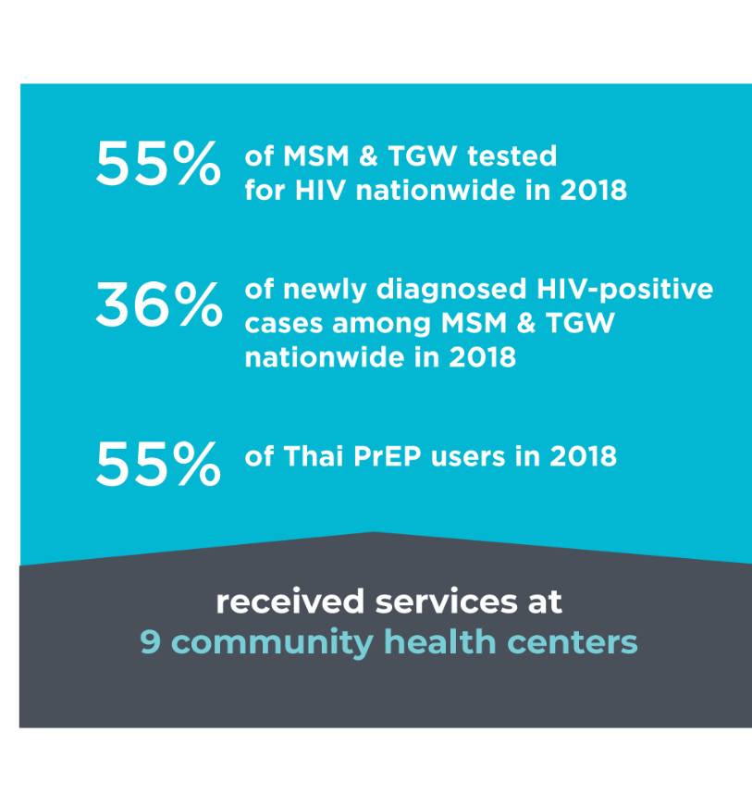
Contribution of KP-led organizations
In 2018, lay providers who are members of these key populations (KPs) provided services in the country delivering;
55% of MSM &TGW tested for HIV;
36% of newly diagnosed HIV-positive cases; and
more than 50 % of Thai PrEP users.

Slide 8
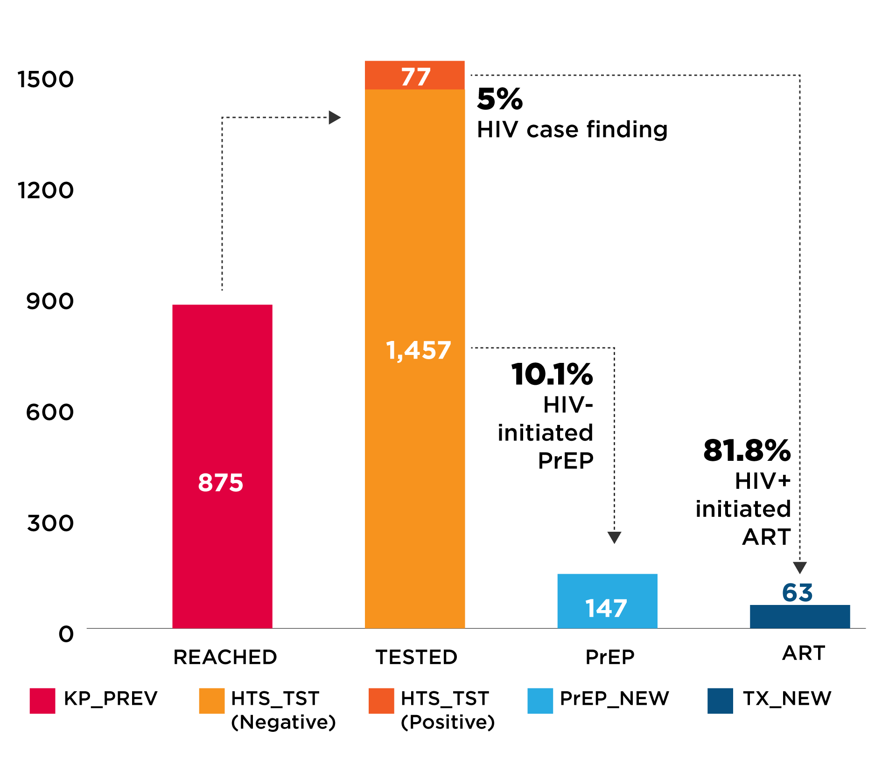
Value of full HIV cascade by KP organizations
Rainbow Sky Association of Thailand (RSAT)
HIV cascade performance 2019 Quarter 2
KP organizations uniquely positioned to conduct full HIV cascade: reach, test, treat, test, retain, and prevent (PrEP)
However, domestic budgets may not be willing nor able to support all of these cascade components

Slide 9
Value of full HIV cascade by KP organizations (cont’d)
Rainbow Sky Association of Thailand (RSAT)
HIV cascade performance 2019 Quarter 2
In Thailand, NHSO currently only supports reach-recruit interventions to promote HIV testing
Advocacy and accreditation in process to promote reimbursements for HIV testing at KP organization, PrEP, and HIV treatment as well

Slide 10
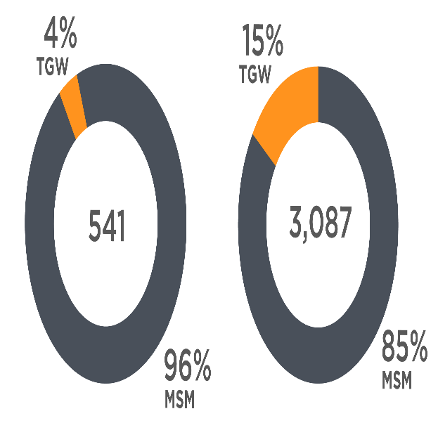
PrEP uptake in public and community (KP-led) sites
Initial PrEP uptake much higher in community sites
Public sector PrEP new cases
FY 17-FY19 Q1*
KPLHS PrEP new cases
FY 16 Q2-FY19 Q1
*Other PrEP users (discordant & other KPs) excluded
Source: Thailand-US Collaboration and Thai Red Cross AIDS Research Centre

Slide 11
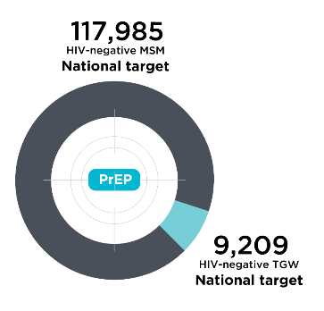
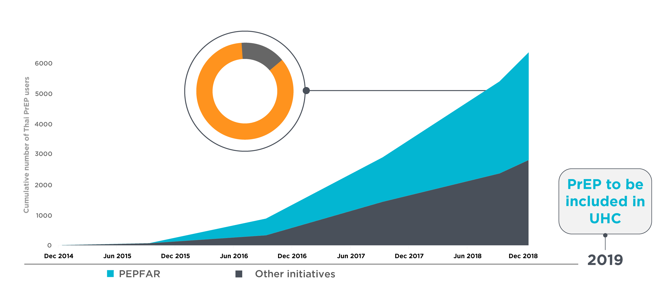
Long way to go: PrEP for epidemic impact needs far higher scale-up
6,000 to 118,000 leap to reach national target
15%
Public sector sites
85%
KP-led sites
How did we get there?
2020

Slide 12
Evolution of PrEP in Thailand: the journey towards financing
PrEP-30 (about US$ 1 per PrEP dose) starts at Thai Red Cross AIDS Research Centre (TRCARC); Now PrEP-15
Thailand provided sites for early PrEP clinical trials, i.e. iPrEX
The Princess PrEP
USAID LINKAGES and Thai Princess support PrEP scale-up through key population-led health services in 2015 (free PrEP)
The 1st Test & Treat project in MSM and TGW in 4 provinces
Princess PrEP
Nov. 2010
Jul. 2011
Dec. 2012
Oct. 2014
Dec. 2014
May 2015
Jan. 2016
HPTN 052, 96% prevention efficacy with immediate ART
National guidelines recommended ART regardless of CD4 count and PrEP
Implementation science in community and government clinics

Slide 13
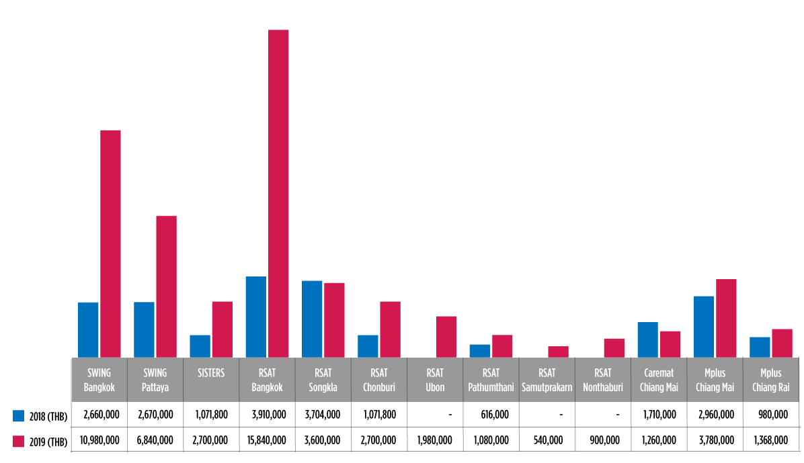
Thai government financing for KP-led organizations
Public sector expenditures for KP HIV prevention have increased significantly since 2016
Improved systems and legal frameworks for enhancing contributions of KP community-based organizations
Accreditation and reimbursement processes and standards for CBOs and private clinics
Management of CBO contracts through provincial sub-grants
Inclusion of PrEP in Universal Coverage
Challenges: Determining appropriate and acceptable costs for services for sustainability
Thai National Health Security Organization (NHSO)
funding trends from 2018 to 2019
305%
313%
156%
-3%
28%
152%
152%
75%
-26%
40%

Slide 14
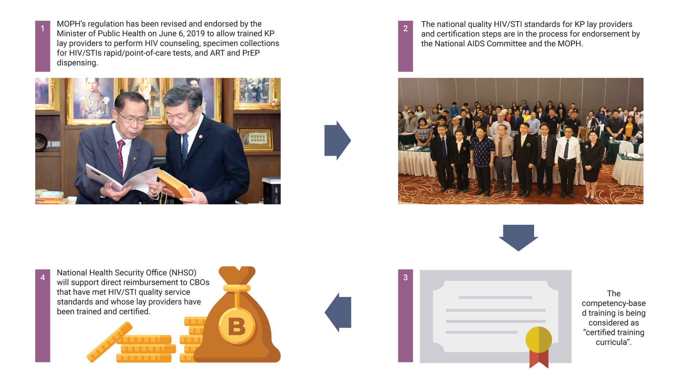
Steps towards transitioning and sustainability

Slide 15
Lessons learned - Careful transition needed
Investment priorities and systems of domestic and international funders are not always the same
Dual investments often needed to support various cost components or HIV cascade components of an organization
USAID has sometimes decided to reinvest in organizations where transitions happen too quickly

Slide 16
Conclusions
Financial transitioning from donor to domestic financing needs to be planned as early as possible and enabled in national laws, policies and guidelines
Success in achieving the UNAIDS 90-90-90 goals by 2020 will be associated with our capacity to put “fast-track” solutions in the hands of those in which they can have the greatest impact – key populations and civil society organizations
KP organizations are uniquely positioned to conduct full HIV cascade services for their clients
Need for a variety of financing mechanisms to channel funds to HIV programs, including social contracting, reimbursements per person tested, treated; Countries can learn from each others methods
International donors need to remain flexible as domestic funding agencies learn to contract with NGOs and CBOs in their countries

Slide 17
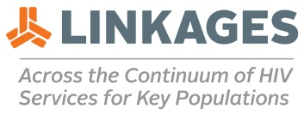
Acknowledgements

